Slide 1
July 6, Anomaly Detection Isolation Forest

Slide 2
Anomaly Detection:
waterDepth = 6 ft (inches)
The issue of inches erroneously recorded as feet is most evident at intuitive inch record levels, notably multiples of (6) six as 6 inch = 1/2 foot
This presents a considerable problem when the water depth is 6 feet, a depth to which our model should be able to accommodate
To tackle this, we initially concentrated anomaly detection efforts on this specific 6x water depth.

Slide 3
Anomaly Detection with feature engineering and isolation forest
Step for anomaly detection:
Trimmed the original dataframe to include only observations with complete relevant variables.
Created a subset of 34,393 observations out of 42,286 where the water depth is 6 feet.
Encoded certain variables as one-hot variables and normalized others using a standard scaler.
Used the IsolationForest method for anomaly detection.
Set the contamination factor to 0.05 (as floor) based on an anticipated error rate of inches mistakenly recorded as feet in the dataset, as mentioned in the Oliver Wing Nature journal article.

Slide 4
Preliminary Findings
IsolationForest from sklearn seemed to effectively identify outliers/anomaly in 'relativeDamage'.
Anomalous data sets (in inches, hopefully) consistently had a lower mean relativeDamage than non-anomalous ones (in feet).
For instance, with a contamination factor of 0.1, mean relativeDamage was 0.23 for anomalies vs 0.4095 for non-anomalies ( mean relativeDamage of 1 foot waterDepth in larger dataset is 0.1985)

Slide 5
Step-by-step Ideas for Validation:
We grouped flood events into 7 day bins per censusBlockGroupFips and median waterDepth was calculated.
Using this bin, we create new dataset where observed waterDepth equals 6 feet, and where waterDepth deviated by 3+ feet from the censusBlock 7 day window median waterDepth.
This new dataset has 13,422 observations was created, 31% of all 6-feet observation
Upon merging with the anomalies flagged by IsolationForest, 1,738 observations (50.5% of anomalies) were noted to have a water depth deviating by 3+ feet from the group bin median*.
This suggests that the IsolationForest may be accurately identifying cases where inches are recorded as feet, as we expect the 3+ difference to be correlated with inch v. feet errors.
*IsolationForest did not have this variable (either median or difference) in the model, as we wished to use it at this point for validation.

Slide 6
New Variable creation
elevationDifferenceCategory - Binned elevation difference variable (10 bins) with missing variable indicator for missing observations
proportionLeqOne - proportion of flood insurance claims for given day and census block with waterDepth less than or equal to 1 (calculated this variable also for waterDepth of 1, 2, 3, 4, 5 and 6)
bool50: A boolean recording if proportionLeqOne is >= .5 (also created bool75, bool80, bool90, and bool95).
medWaterDepth - median waterDepth for a three day window (centered at date of observation’s dateOfLoss) per census block (also calculated 25th percentile, 75th percentile, etc.
diffMedWaterDepth: Difference between observation’s waterDepth and median water depth of county for three day window cenetered at waterDepth’s dateOfLoss.

Slide 7
Final Variables Included
One-Hot Categorical Variables:
'floodEvent'
'floodEvent'
'ratedFloodZone'
'causeOfDamage'
'state'
‘yearOfLoss’
'occupancyType'
'floodproofedIndicator'
'rateMethod'
'elevationDifference_category'
Boolean Categorical Variables:
'postFIRMConstructionIndicator'
'elevatedBuildingIndicator'
'Bool75'
'Bool50'
'Bool80'
'Bool90'
Normalized Variables:
‘relativeDamage'
'proportionLeqOne',
'medWaterDepth'

Slide 8
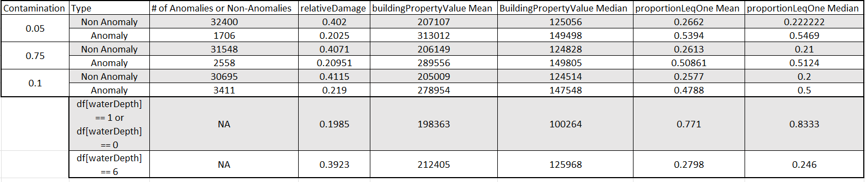
Covariate Comparison - IsolationForest
Setting contamination at 0.1, 63% of identified anomalies showed a difference over 3 feet between observed waterDepth and median 3-day waterDepth of census blocks.
In comparison, only 35.8% of all observations with a waterDepth of 6 feet had similar differences.
Notably, these difference were not provided as variables to the model.
This suggests potentially effective anomaly detection, as larger disparities are more common in anomalies."
Note: Although the variable "buildingPropertyValue" was not supplied, it is worth noting that the IsolationForest consistently correlates higher values of homes (median and mean) with its anomaly detection.

Slide 9
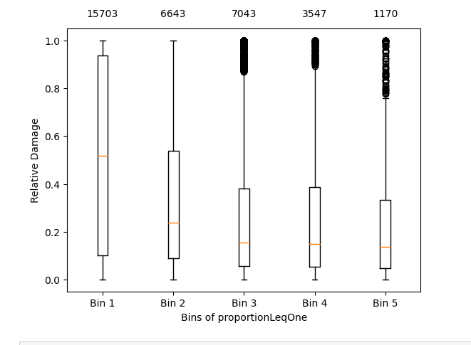
Figure 1: All observations with 6 inches of flood depth
More likely to be 6 inches
The dataset consists of all observations with 6 feet of flood depth
The bins contain these data points at varying percents of less than or equal to 1 foot of water depth for bin with the day and census block.
For example, bin 1 is the observations with 6 feet of flood depth where 0 to 20% of the observations in the day and census block are flood observations of less than or equal to 1 foot.
This figure potentially indicates that observations with higher proportionLeqOne values may be more likely to be inches (which would explain the dramatic depression in median relativeDamage).

Slide 10
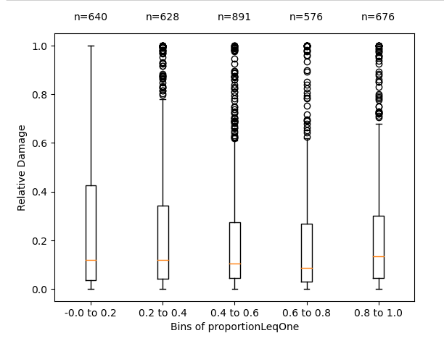
Figure 2: Anomalies detected for contamination = .1
All data here is expected/desired to be in inches:
The dataset for this figure consists of the observations that were detected as anomalies by the isolation forest.
The percent of observations tagged as anomalies increase with each bin (4%, 9%, 13%, 16%, and 58%).
This is result is consistent with what we would expect would happen if more anomalies occur at higher percentages of less than or equal to 1 foot of water depth for the same day/census block.
This suggests that the isolation forest is tagging observations recorded in inches as anomalies, which is further supported by the median relative damage values.

Slide 11
Next steps
Use other anomaly detection algorithms and check overlap between them and IsolationForest
Elliptic Envelope
Local Outlier Factor
One-class SVM
Gaussian Mixture Models
Autoencoder
Also, begin attempting to do analysis on larger subset of dataframe or whole dataframe. Try to resolve feet v. inch problem at higher waterDepths.

